Slide 1
Text Complexity the Common Core Standards for English Language Arts, Literacy in History/Social Studies, Science and Technical Subjects
3-5 Learning Community
Early Release
January 17, 2013

Slide 2
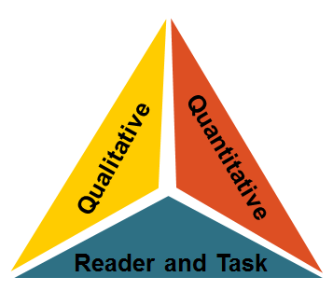
Introductory Activity
Using the Wordle in your packet, with your group create a definition for text complexity. Make sure you include the three components
Notes:
“The Common Core Standards hinge on students encountering appropriately complex texts at each grade level in order to develop the mature language skills and the conceptual knowledge they need for success in school and life” (p. 3).
Wordle Activity-Slide 2 (5 min)
Explain what a wordle is. This wordle was created with an article about text complexity. At your table group, come up with a working definition for text complexity. Share.

Slide 3
Text Complexity
The Common Core Standards hinge on students encountering appropriately complex texts at each grade level in order to develop the mature language skills and the conceptual knowledge they need for success in school and life” (p. 3).
Notes:
What is Text Complexity? (5 min)
Discuss slides 3-5 together and then turn and talk answering the question, “How will text complexity effect our classroom instruction?

Slide 4
Reading Standards for Literature Example grade level Standard 10
Third Grade: By the end of the year, read and comprehend literature, including stories, dramas, and poetry, at the high end of the grades 2–3 text complexity band independently and proficiently
Fourth Grade: By the end of the year, read and comprehend literature, including stories, dramas, and poetry, in the grades 4–5 text complexity band proficiently, with scaffolding as needed at the high end of the range.
Notes:
Kindergarten: Actively engage in group reading activities with
purpose and understanding.
First Grade: With prompting and support, read prose and
poetry of appropriate complexity for grade 1.
Second Grade: By the end of the year, read and comprehend
literature, including stories and poetry, in the
grades 2–3 text complexity band proficiently,
with scaffolding as needed at the high end of the
range.
Third Grade: By the end of the year, read and comprehend
literature, including stories, dramas, and poetry,
at the high end of the grades 2–3 text complexity
band independently and proficiently

Slide 5
Example grade level Standard 10 Continued….
Fifth Grade: By the end of the year, read and comprehend literature, including stories, dramas, and poetry, at the high end of the grades 4–5 text complexity band independently and proficiently.
Sixth Grade: By the end of the year, read and comprehend literature, including stories, dramas, and poems, in the grades 6–8 text complexity band proficiently, with scaffolding as needed at the high end of the range.

Slide 6
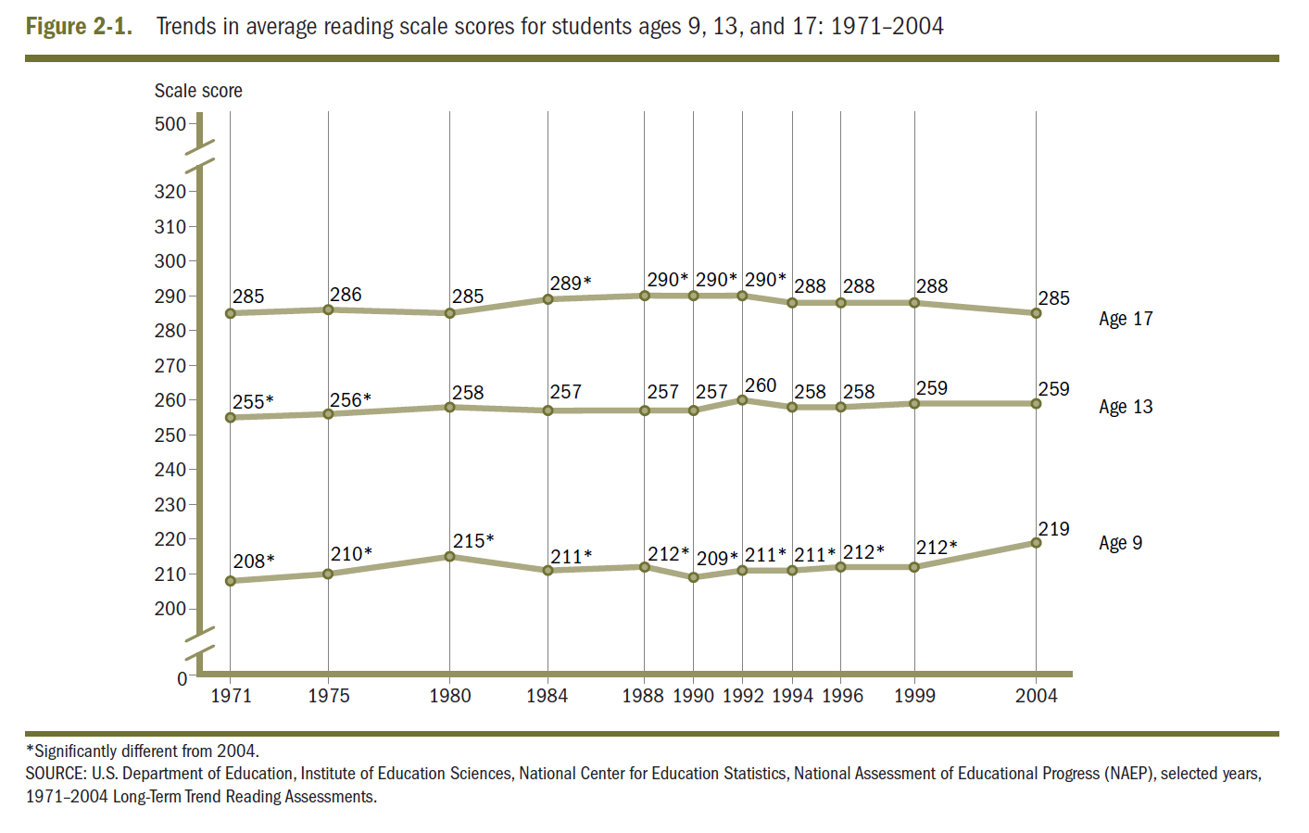
Why Is Text Complexity Important?
Why Text Complexity Matters
Notes:
http://media.doe.in.gov/commoncore/MajorShift3.html
PLAY .48-3.38 minutes of this video
Share the video, “ Why is text complexity important?” Slides 6-9 (7min)
Possible reflection questions….
After hearing this video, turn to a partner and talk about what you are thinking about why text complexity is being addressed in the Common Core.
What surprises you with the levels of post high school reading expectations?
Looking at the Lexile chart, how do the Lexile ranges effect your grade level?

Slide 7
Reflection Question
Why do you think text complexity is being addressed in the Common Core?

Slide 8
Text Complexity Comparison: Then and Now
Notes:
http://www.sde.idaho.gov/site/common/ELAcore/docs/toolkit/lexile%20bands%20and%20stretch.pdf
Looking at the Lexile chart how do lexile ranges effect your grade level?

Slide 9
Notes:
Measures such as:
Word length
Word frequency
Word difficulty
Sentence length
Text length
Text cohesion

Slide 10
Three Components of Text Complexity
Quantitative: Readability measures
and other scores of text complexity
1
Qualitative: Levels of meaning, structure, language conventionality and clarity, and
knowledge demands.
2
Matching Readers to Text: Reader variables (such as motivation, knowledge, and experiences) and task variables (such as purpose and the complexity. Generated by the task assigned and the questions posed)
3
Notes:
Quantitative: Readability measures
and other scores of text complexity
Qualitative: Levels of meaning, structure, language
conventionality and clarity, and knowledge demands.
Matching Readers to Text: Reader variables (such as motivation, knowledge, and experiences) and task
variables (such as purpose and the complexity
generated by the task assigned and the questions
posed)

Slide 11
Video for Text Complexity
Text Complexity
Notes:
Time .55-2:55
http://vimeo.com/18759175
Extracted clip
http://www.westerville.k12.oh.us/olc/class.aspx?id=36228&s=4998

Slide 12
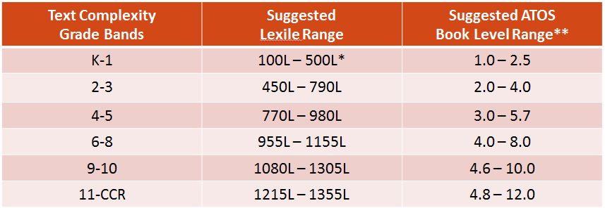
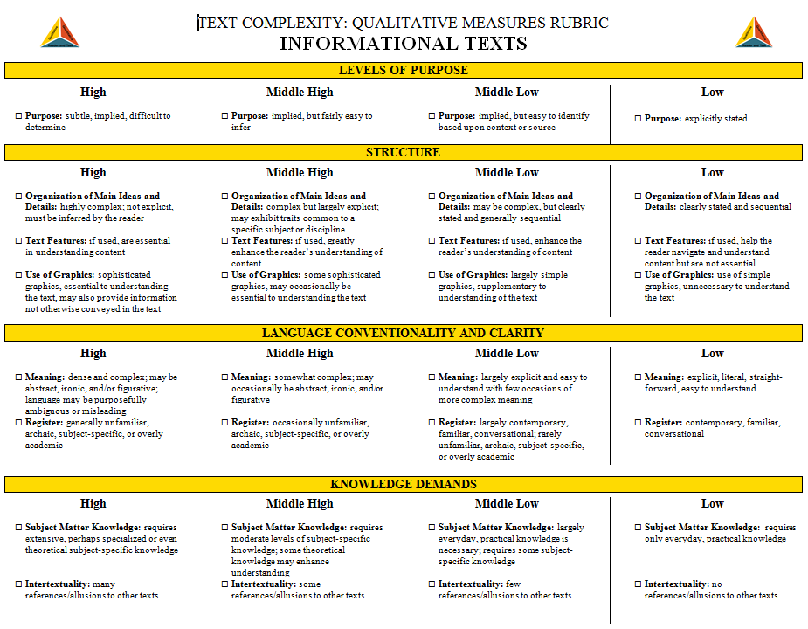
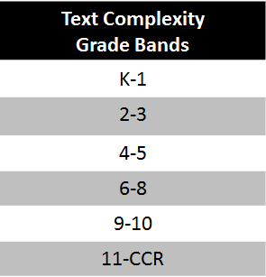
Determining Text Complexity
A Four-step Process:
Determine the quantitative measures of the text.
Analyze the qualitative measures of the text.
Reflect upon the reader and task considerations.
Recommend placement in the appropriate text complexity band.
Notes:
Components of Text Complexity Instruction Slides 10-27- (20 min)
Quantitative Measures (Slides 13-15)
http://www.arbookfind.com/UserType.aspx
http://www.lexile.com/
Share these two sites along with the PowerPoint Slides. Walk teachers through the websites and let them know that we are going to give them the time in the computer room to explore the websites.
Guiding Question:
How do you see yourself using these websites to support your classroom instruction?

Slide 13
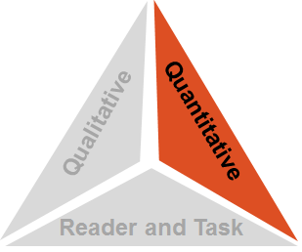
Step 1: Quantitative Measures
Measures such as:
Word length (syllables)
Word frequency
Word difficulty (also frequency of unfamiliar words)
Sentence length
Text length
Text cohesion
Notes:
Measures such as:
Word length
Word frequency
Word difficulty
Sentence length
Text length
Text cohesion
Most publishers give grade brand equivalents or lexile levels for their texts.
Quantitative measures are determined using readability formulas.
The lexile framework is aligned with the Common Core Standards.
You also have ATOS Readability Formula with AR.
I want to caution you, however, you really have to look at all three components of determining text complexity. Using just a quantitative measure can result in some major errors. For example, the very complex, Pulitzer Prize winning, Grapes of Wrath was ranked appropriate for 2nd or 3rd grade because of all of the dialogue and colloquial language.

Slide 14
Step 1: Quantitative Measures
Notes:
Measures such as:
Word length
Word frequency
Word difficulty
Sentence length
Text length
Text cohesion
Use Giant Eagle Example

Slide 15
Step 1: Quantitative Measures
Notes:
We will be exploring and going to the lab.
Accelerated Reader Website
http://www.renlearn.com/ar/
“Accelerated Reader and the Common Core State Standards”
http://doc.renlearn.com/KMNet/R004572117GKC46B.pdf
Kansas All Books Connect Website
http://kansas.bookconnect.com/default.aspx

Slide 16
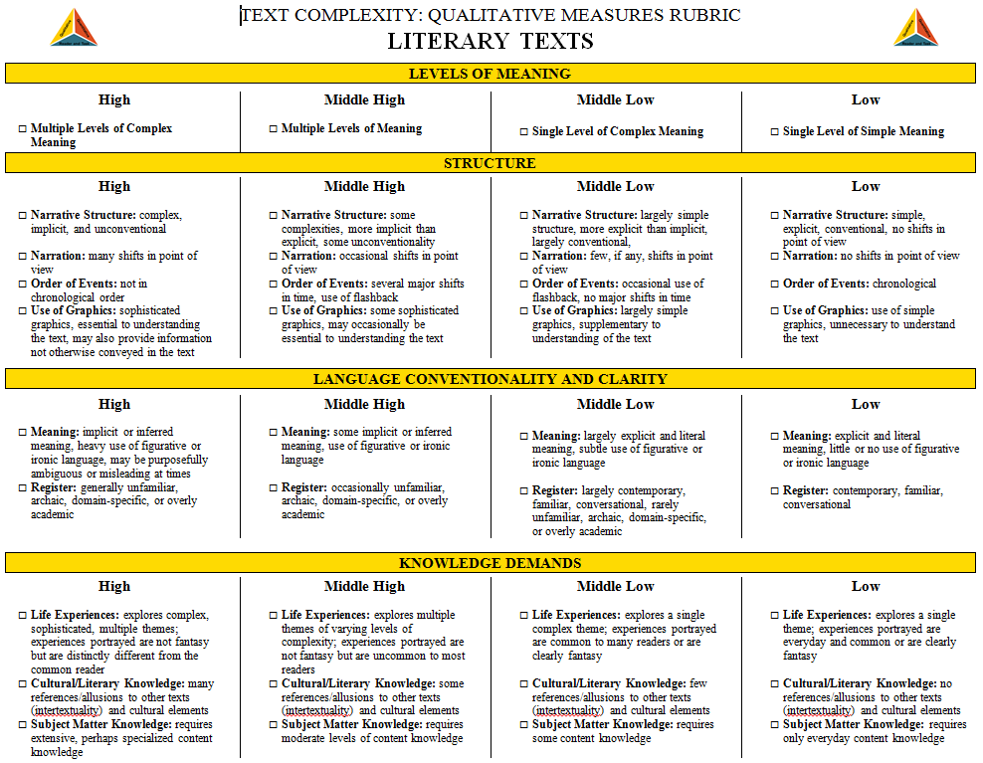
Step 2: Qualitative Measures

Slide 17
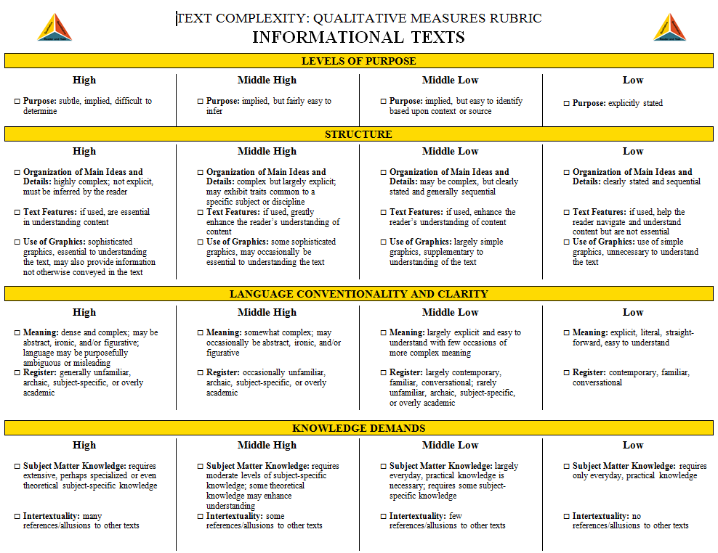
Step 2: Qualitative Measures

Slide 18
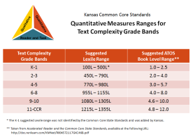
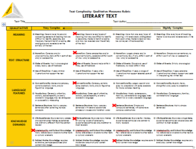
Step 2: Qualitative Measures
Qualitative
Quantitative
Reader and Task
From examining the quantitative measures, we knew:
Lexile Text Measure:
870L
ATOS Book Level:
5.6
But after reflecting upon the qualitative measures,
we believed:
Notes:
Qualitative Measures (Slides 16-18)
Share the Literary Text and Informational Text Rubrics and discuss. These slides ( 10 and 11) are also part of the Powerpoint.

Slide 19
Video Example Text Complexity Band 2-6
Text Complexity Band 2-6
Notes:
TIME is 7:42-12:27
2-3
4-5
6-8 grades
http://www.westerville.k12.oh.us/olc/class.aspx?id=36228&s=4998

Slide 20
Step 3: Reader and Task Considerations
Considerations such as:
Motivation
Knowledge and experience
Purpose for reading
Complexity of task assigned regarding text
Complexity of questions asked regarding text
Qualitative
Quantitative
Reader and Task

Slide 21
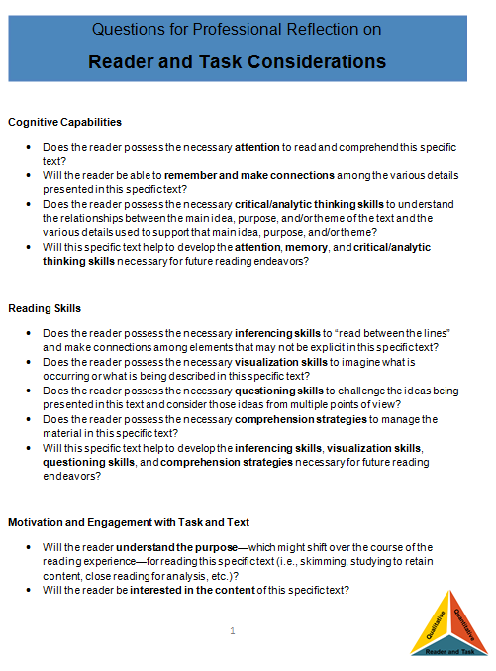
Step 3:
Reader and Task Considerations
Qualitative
Quantitative
Reader and Task
Questions for Professional Reflection on Reader and Task Considerations:
The questions provided in this resource are meant to spur teacher thought and reflection upon the text, students, and any tasks associated with the text.
Notes:
Harry Potter- students can get lots of support from having watched the movies.

Slide 22
Step 3: Reader and Task Considerations
Qualitative
Quantitative
Reader and Task
The questions included here are largely open-ended questions without single, correct answers, but help educators to think through the implications of using a particular text in the classroom.

Slide 23
Step 4:
Recommended Placement
Qualitative
Quantitative
Reader and Task
Lexile Text Measure:
870L
ATOS Book Level:
5.6
Notes:
Using this protocol, we progressed through each leg of the text complexity model: (1) quantitative measures, (2) qualitative measures, and (3) reader and task considerations. Now we are ready to review all three legs one last time and make a final recommendation for placement of this text into a text complexity grade band.

Slide 24
Step 4:
Recommended Placement
Qualitative
Quantitative
Reader and Task
Based upon all the information—all three legs of the model—the final recommendation for To Kill a Mockingbird…
Notes:
Based upon all three legs of the model, we felt the most appropriate placement for the novel was grades 9-10.

Slide 25
Text Complexity Analysis Template

Slide 26
So what does this really look like in my classroom?
Summary-Key to Learning
Notes:
http://vimeo.com/18759175
Time 12:15-14:15(end)
http://www.westerville.k12.oh.us/olc/class.aspx?id=36228&s=4998
What does this look like in my classroom?
Watch the video and discuss.
Guiding Questions: How is text complexity being used with the students that were reading
in the different classrooms?
What are some ways that you would address text complexity in the
classroom? In what content areas, can you address text complexity?

Slide 27
For More Information
Please see Melissa Krempasky’s website
http://www.westerville.k12.oh.us/olc/teacher.aspx?s=4998

